Slide 1








isn’t just an app — it’s your ultimate emergency sidekick. Whether it’s a medical crisis, ﬁre alert, safety threat, or a desperate need for blood — ResQ puts every lifesaving service right at your ﬁngertips. One tap, and boom — help is on the way, with real-time tracking, instant alerts, and zero confusion. No more juggling numbers or waiting in panic. It’s fast. It’s smart. It’s your personal command center for survival — because when seconds matter, ResQ delivers. Every. Single. Time..
Presented By X hunters Team Members:-
Souvik Biswas
Ishika Kundu
Sk.Rahul

Slide 2










Ambulance, police, ﬁre, blood banks — all on different apps or calls. When lives are on the line, chaos kills.
Emergency calls often miss exact GPS data. That means responders waste precious minutes trying to ﬁnd you
Current systems don’t know who you are, what you need, or how to prioritize your situation.
Manual info-sharing, poor coordination, and outdated systems cost lives every single day.
These issues lead to critical delays. An estimated 10,000+ preventable deaths occur annually. ResQ addresses these challenges directly.

Slide 3



















Consolidates all emergency services into one intuitive app.
Supports text, video, and TTY/TDD for all users.
Instantly transmits critical user data to ﬁrst responders.
AI-powered routing optimizes response, based on incident and resources.
Goal: Reduce initial dispatch time by 25%, aiming for a 15-20% overall reduction in response times.

Slide 4











Cross-platform eﬃciency (iOS/Android).
For scalable database.
For critical native modules.
For eﬃcient retrieving of data.
Render.
For mapping and navigation.
Scalable and eﬃcient APIs.
Precise indoor/outdoor positioning.
Data security is paramount, with end-to-end encryption (AES-256). We ensure full compliance with HIPAA, GDPR, and CCPA.

Slide 5



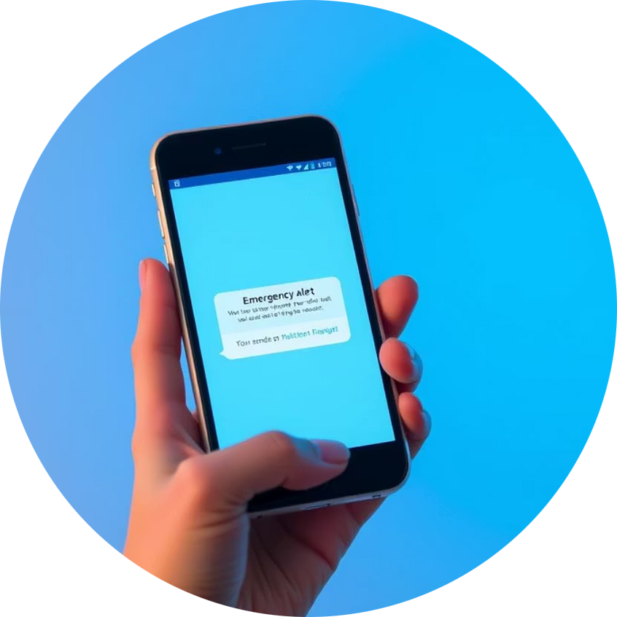




ResQ Mobile App (iOS/Android) triggers emergency alerts.
AWS services validate users and retrieve proﬁles, rapidly determining incident types.
Routes critical data to appropriate dispatch modules, ensuring secure information transfer.
Connects users with nearest responders using real-time GPS and APIs.
Real-time data pushed to MDTs and tablets, providing immediate ﬁeld insights.

Slide 6























Allow users (especially injured or panicked ones) to speak or whisper their request. The app uses NLP to auto-ﬁll emergency forms and detect tone-based urgency..
Find nearby blood banks with real-time inventory and request urgent blood types in just a few taps.
Instantly call and track the nearest available ambulance with live GPS and ETA updates.
Trained nearby volunteers (paramedics, doctors, ﬁreﬁghters) get notiﬁed before
oﬃcials if they are within 500m of the
emergency.
Built-in translation for 10+ languages. Bridges crucial communication gaps.
ResQ offers unparalleled eﬃciency. It enhances safety through innovative technology.

Slide 7









Faster and smarter help based on actual need — critical cases don’t wait in the queue.
Personalized treatment starts faster — no time wasted asking medical history.
Collaborate with healthcare systems. Engage government and smart city initiatives.
Inclusive support for hearing/speech-impaired users — no one left out in danger.
We envision a world where emergency response is seamless and instant. ResQ is building that future. Our monetization strategy includes a freemium model and B2B licenses.

Slide 8









Dive into the technical heart of ResQ. Our GitHub repository offers a transparent look at our robust architecture, smart algorithms, and the collaborative development behind our uniﬁed emergency lifeline. Explore the code, contribute to our mission, or simply learn more about how ResQ works.
https://github.com/DanX06-lab/ResQ

